Slide 1
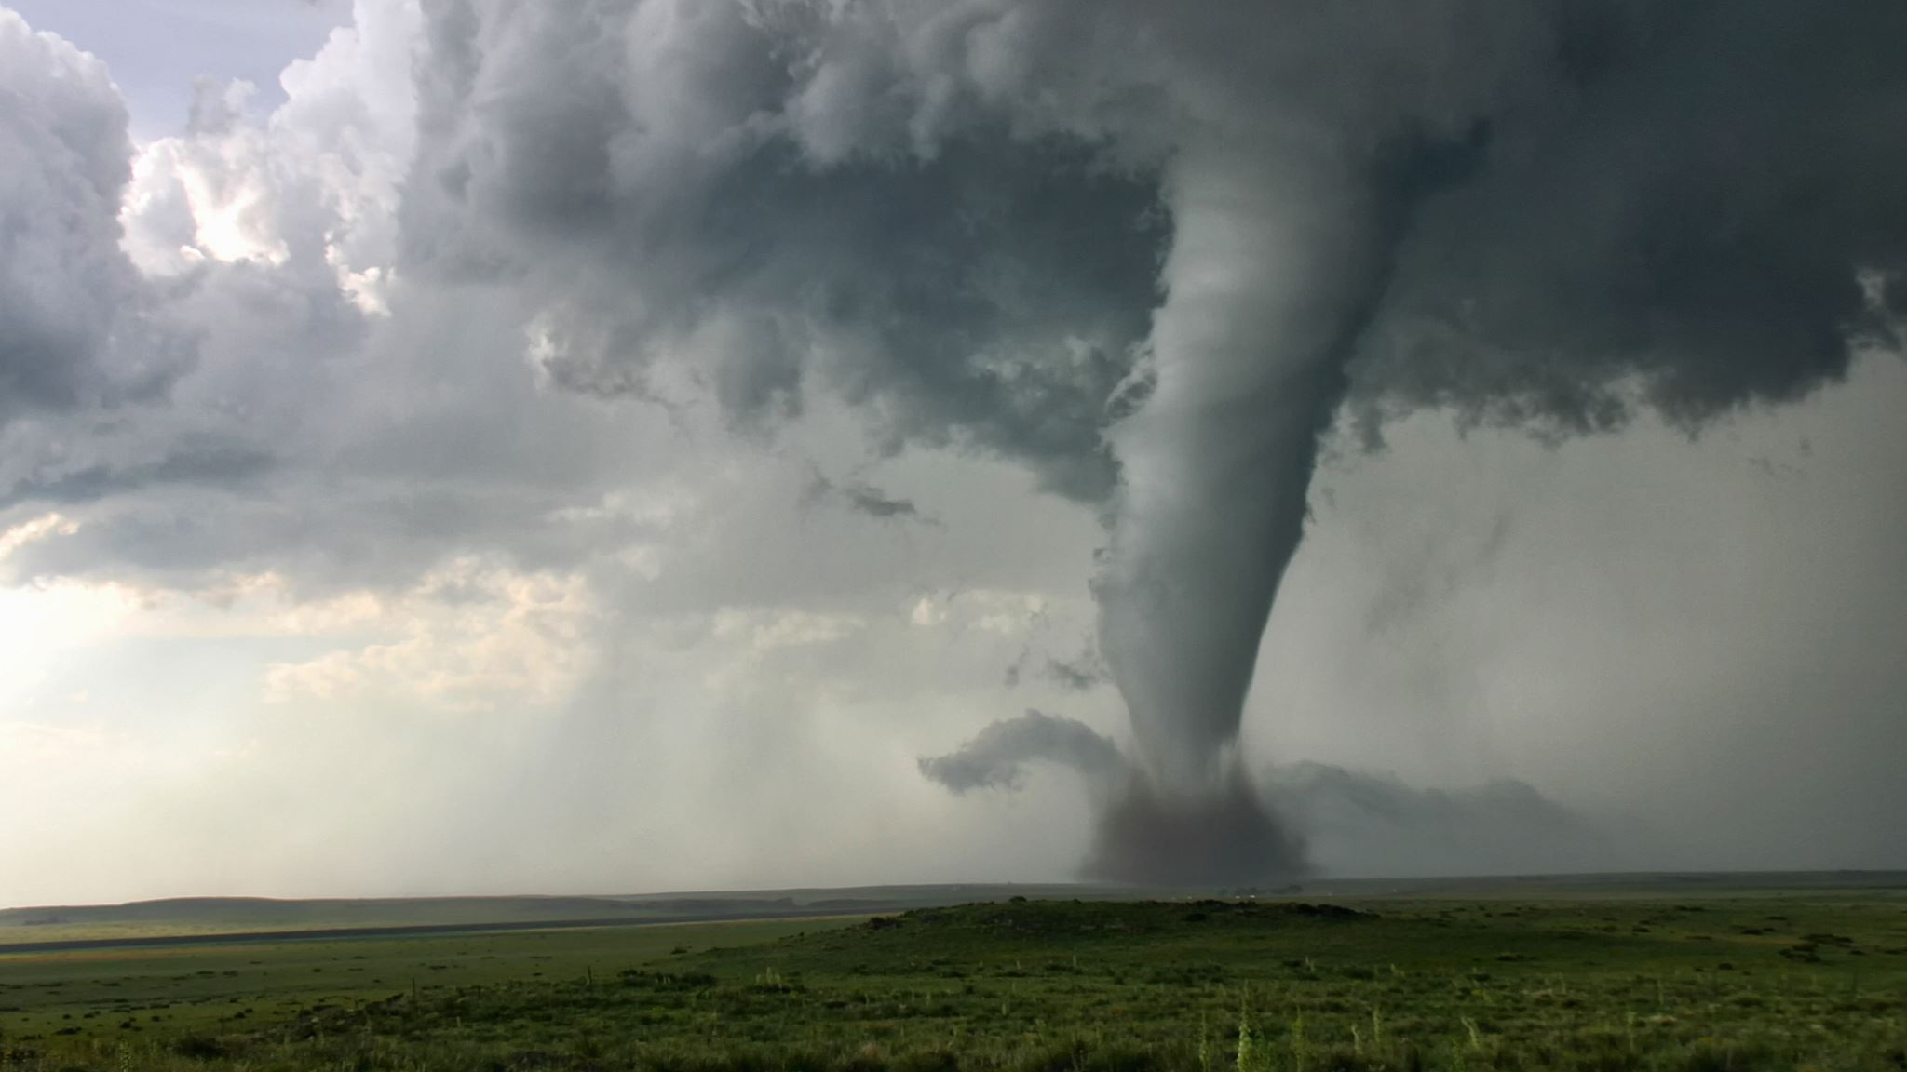
Tornado Event Analysis

Slide 2


About Me
Experience
Retired Army Signal Officer
Former Microsoft ITSM Consultant
Education
MSCS , Colorado Technical University
BA Sociology, University of New Mexico
Korean Linguist, Defense Language Institute
Certifications
ITIL v3 Expert
Certified Knowledge Manager
Microsoft Power BI Analyst

Slide 3
Situation
Problem Statement: Predict budgetary categories associated with tornado events in order to improve the quality and efficiency of FEMA budget planning and forecasting
Solution: Use ML on historical data to predict budget categories associated with specific tornados based on information collected in the immediate aftermath of an event

Slide 4
Data Science Framework
Obtain
Scrub
Explore
Model
Interpret

Slide 5
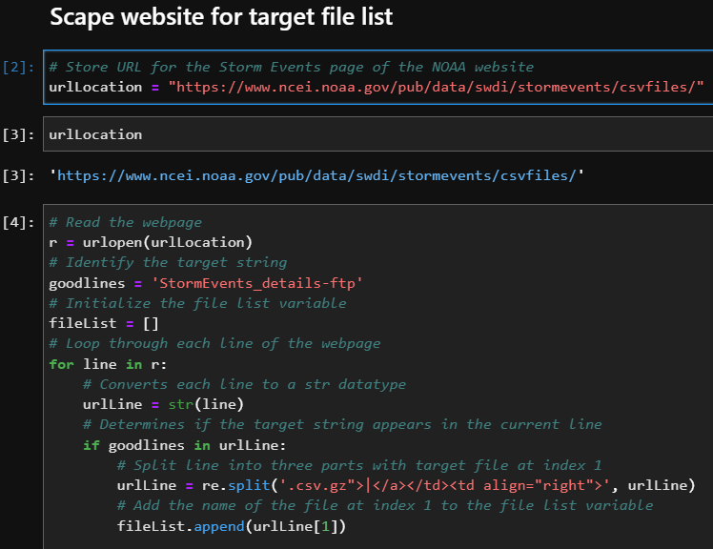
Obtain
Source: National Oceanic and Atmospheric Administration website
Data Profile
73 Compressed Files
1.7M Rows and 51 Columns
Years: 1950 to 2022

Slide 6
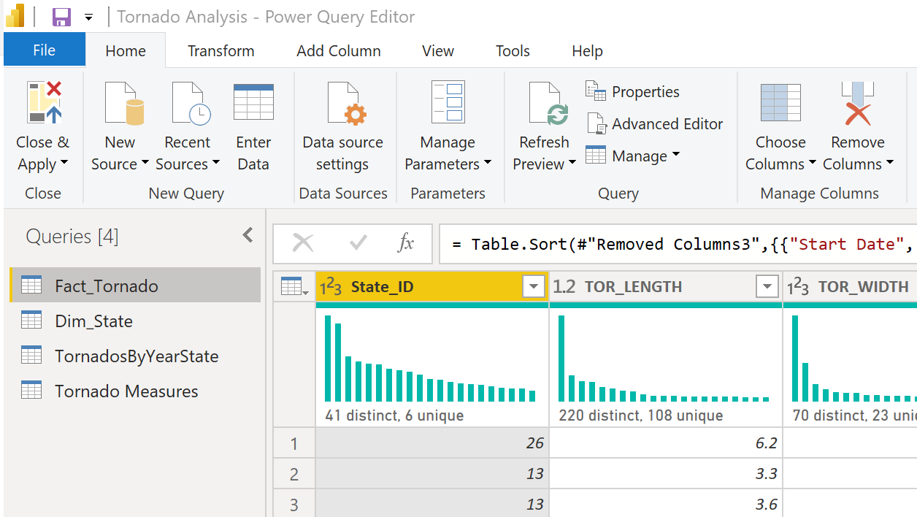
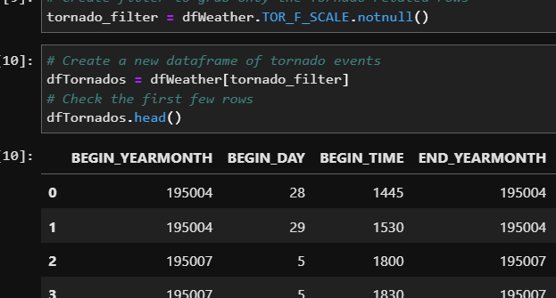
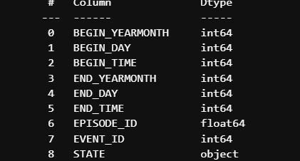
Scrub
Python
Power Query

Slide 7
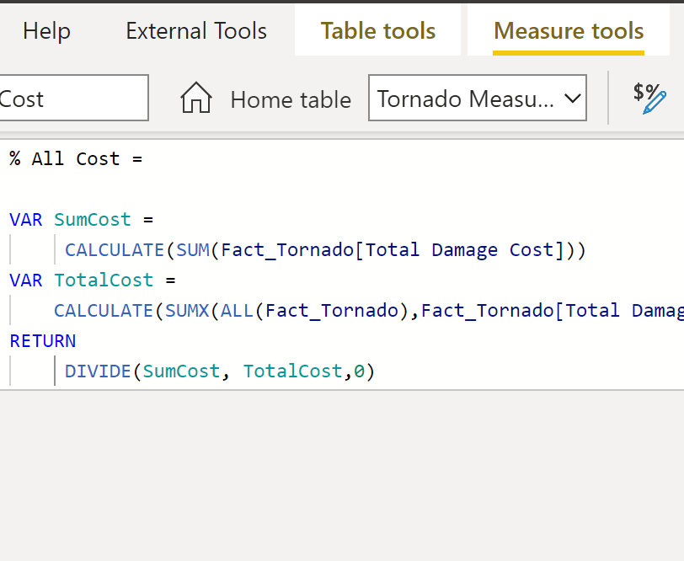
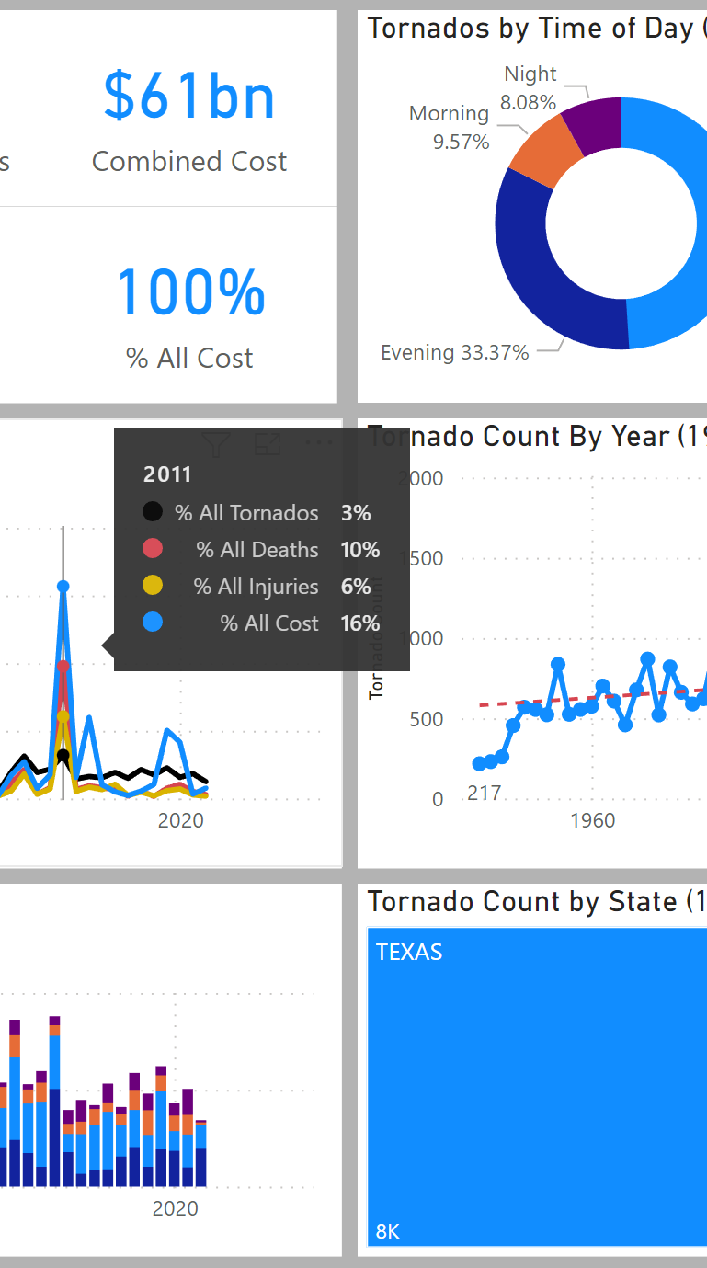
Explore
Power Query
DAX
Power BI Visuals

Slide 8
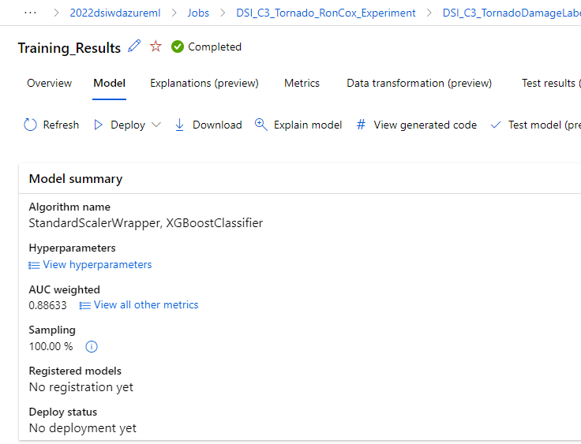
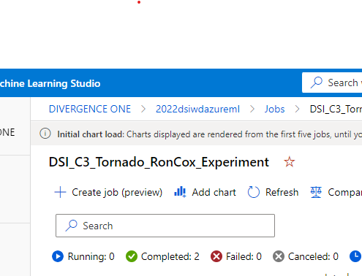
Model
Automated Machine Learning
Train/Test Machine Learning Model

Slide 9
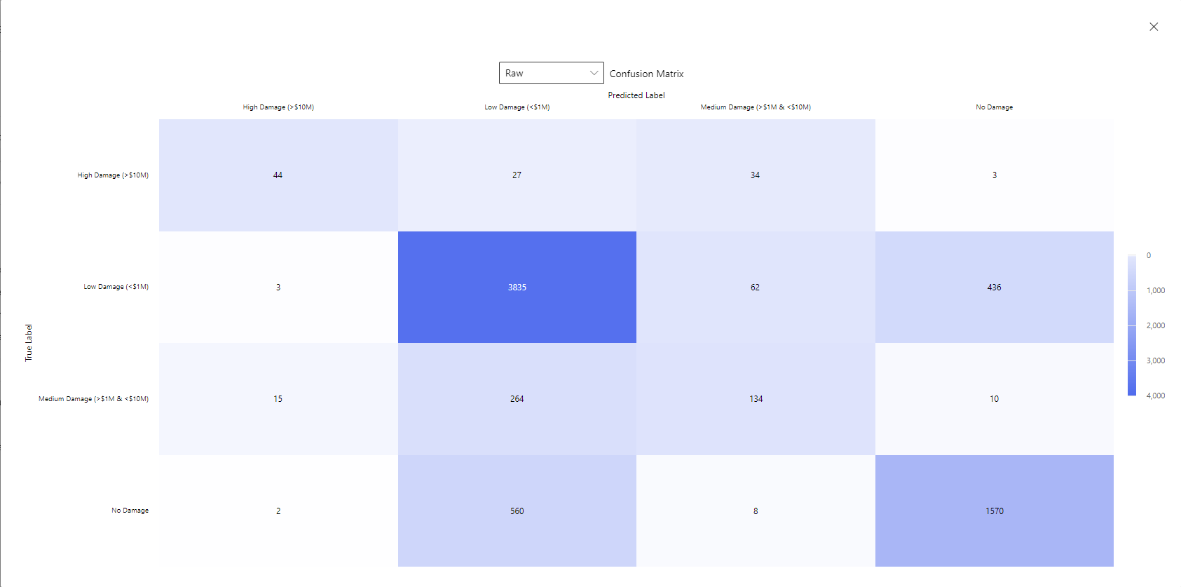
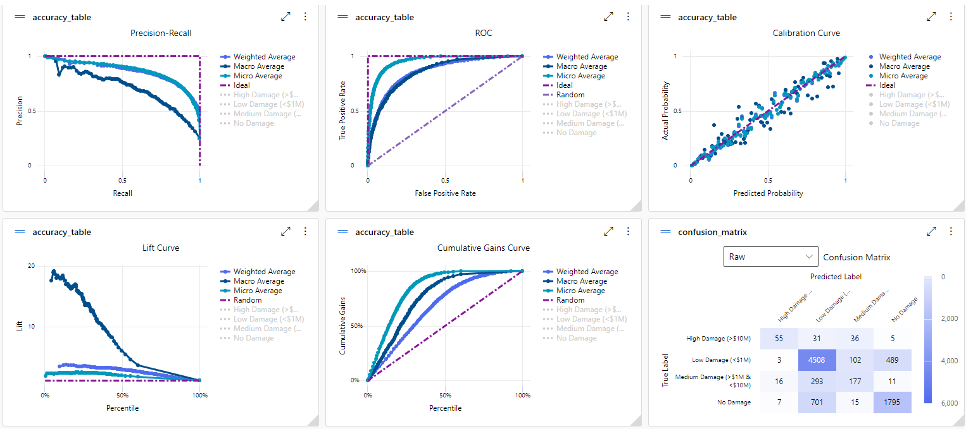
Interpret
Train Results
Test Results

Slide 10
Post Implementation Review
Pain Points
Problem Statement
Factor Analysis
ML Results Interpretation
Lessons Learned
Quality Dataset
Domain Expertise

Slide 11

Questions

